Slide 1
Excel XLSX
Notes:
[Mandatory Slide] This would be the introduction slide of the topic that you are covering in this subsection.
When this slide plays, you could talk about the main aim that we’d be covering in this video.

Slide 2
In this Video, we are going to take a look at…
The Excel XLSX format
Libraries to work with Excel XLSX
Code: read and write a Excel XLSX file
Notes:
[Mandatory Slide]
Before the start of the video, we’d like to highlight what are important topics or pointers that we’d be covering in this video. This slide would immediately follow the intro/name slide. This would just be say 2-3 points for the viewers to know what they are getting into.

Slide 3
The Excel XLSX format (1/2)
XLSX is the XML-based format (once proprietary to Microsoft©) used by the Excel spreadsheet manager.
Features:
Each workbook contains one or more sheets, each one being a data matrix
Each sheet is composed of rows (named with numbers) and columns (named with letters)
Cells, each one being referenced by a row and a column, may contain values or formulas
Values is typed data (eg. numbers, strings, booleans)
Formulas are functions that dynamically calculate the value of a cell based on other cells’ values
Notes:
This slide can also be used to cover topics that can be represented by an image/graph etc. Information which is half image/half information type. Like shown in the example above.

Slide 4
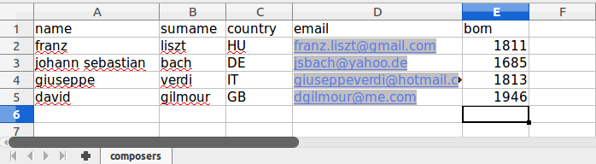
The Excel XLSX format (2/2)
COLUMNS
ROWS
=AVERAGE(E2:E5)
SHEETS
CELL
FORMULA
Notes:
[Mandatory Slide]
Before the start of the video, we’d like to highlight what are important topics or pointers that we’d be covering in this video. This slide would immediately follow the intro/name slide. This would just be say 2-3 points for the viewers to know what they are getting into.

Slide 5
Libraries to work with Excel XLSX
the openpyxl library
the xlrd library
the xlswriter library
We’ll use the openpyxl in our code sample
Notes:
[Mandatory Slide]
Before the start of the video, we’d like to highlight what are important topics or pointers that we’d be covering in this video. This slide would immediately follow the intro/name slide. This would just be say 2-3 points for the viewers to know what they are getting into.

Slide 6
Code: read and write
an Excel XLSX file
Notes:
Something that needs to grab the viewers attention!!

Slide 7
Summary
The Excel XLSX format
Libraries to work with Excel XLSX
Code: read and write a Excel XLSX file
Notes:
This slide, like mentioned is to summarize the various videos we have seen in this section. This gives the viewers a sense of achievement that they have covered exactly what they were looking for.

Slide 8
PDF
Next Video
Notes:
[Mandatory Slide]
Here the name of the next video needs to be mentioned. The narration as you guessed it would be just letting the viewer know exactly where we are at and what we’d be taking over next! ☺

